Slide 1

CSCI 4237
Software Design for Handheld Devices
Extra Lecture - Dialogs
Mike Cobb

Slide 2
Dialogs

Slide 3
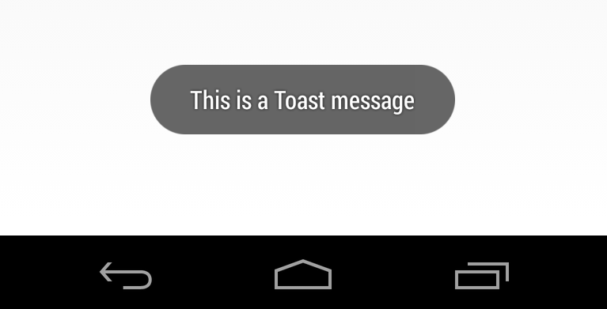
Toast
Toasts are short messages which pop in near the bottom of the screen.

Slide 4
Toast
Toasts are short messages which pop in near the bottom of the screen.
Good for small informative messages.

Slide 5
Toast
val toast = Toast.makeText(
this,
"This is a Toast message",
Toast.LENGTH_SHORT
)
toast.show()

Slide 6
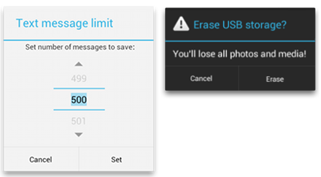
Dialogs
Small windows that appear over Activities.
Alerting the user.
Asking for input / decision.

Slide 7
Dialogs
Easiest way is to use AlertDialog.Builder to create / show a Dialog with a pre-defined look.
https://developer.android.com/guide/topics/ui/dialogs#AlertDialog
You can also specify a custom layout and functionality, if desired.

Slide 8
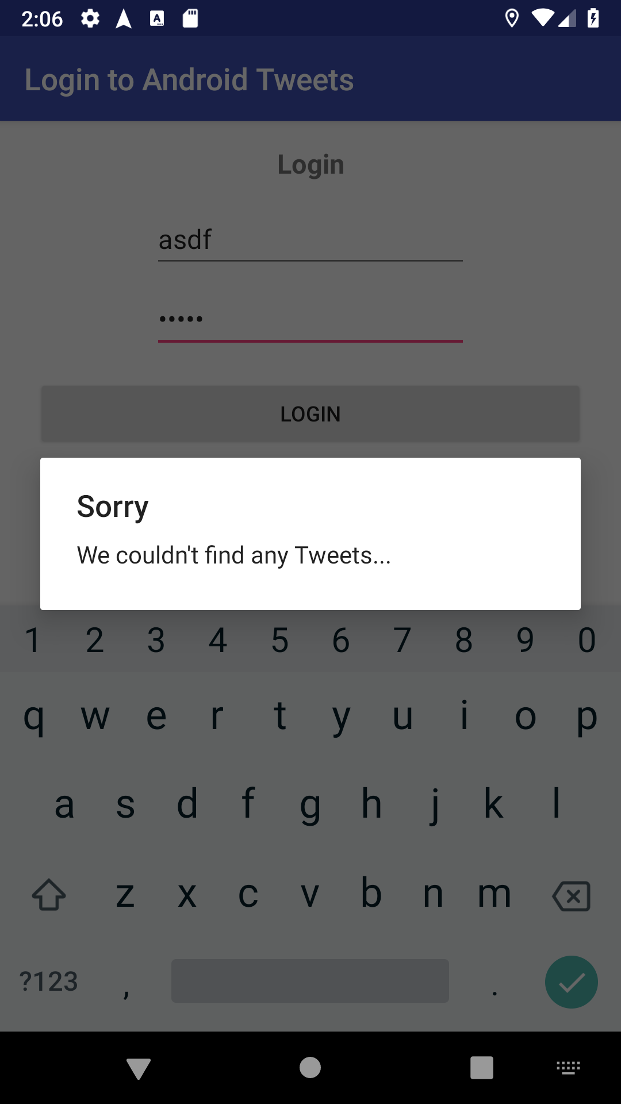
Simple Dialog
AlertDialog.Builder(this) .setTitle("Sorry") .setMessage("We couldn't find any Tweets...") .show()

Slide 9
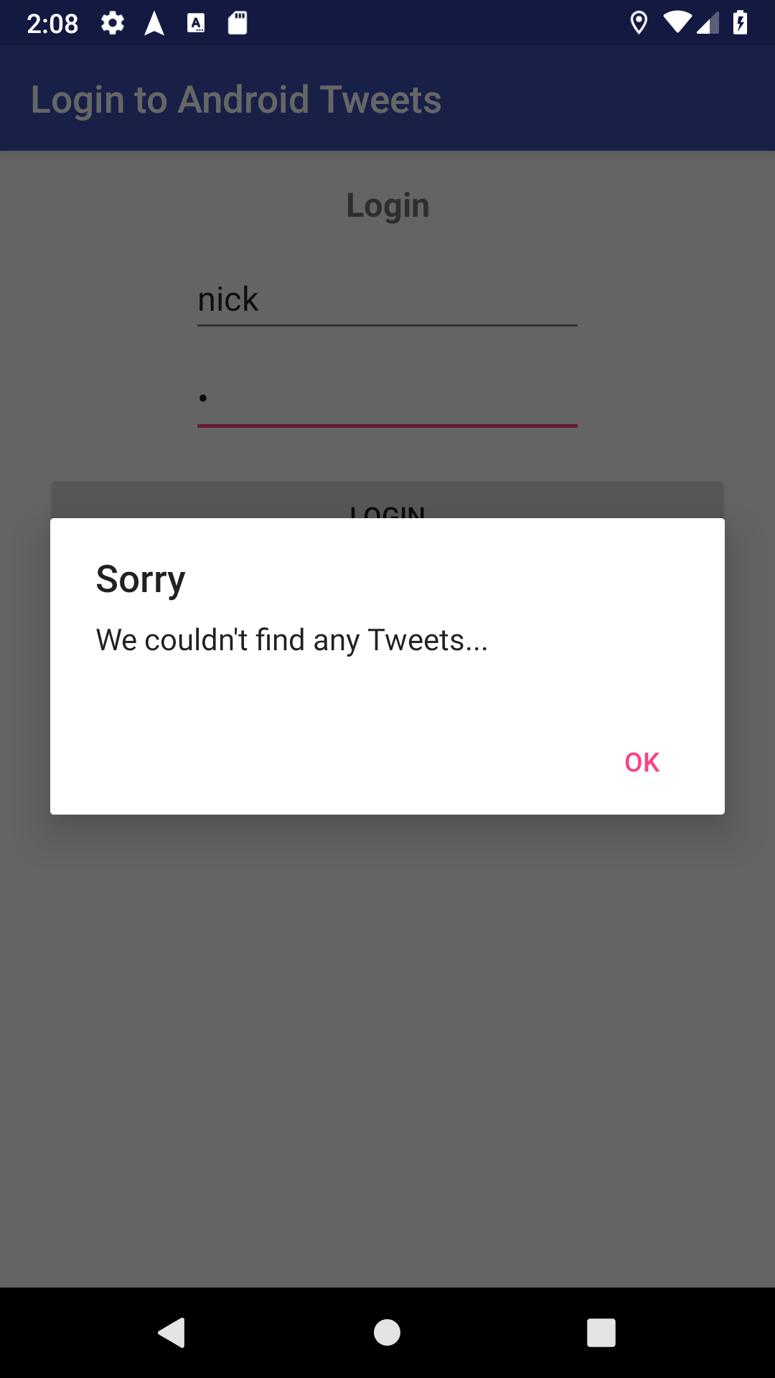
One-Button Dialog
AlertDialog.Builder(this) .setTitle("Sorry") .setMessage("We couldn't find any Tweets...") .setPositiveButton("OK") { dialog, which -> // User pressed OK } .show()

Slide 10

Two-Button Dialog
AlertDialog.Builder(this) .setTitle("Sorry") .setMessage("We couldn't find any Tweets...") .setPositiveButton("OK") { dialog, which -> // User pressed OK } .setNegativeButton("Cancel") { dialog, which -> // User pressed Cancel } .show()

Slide 11
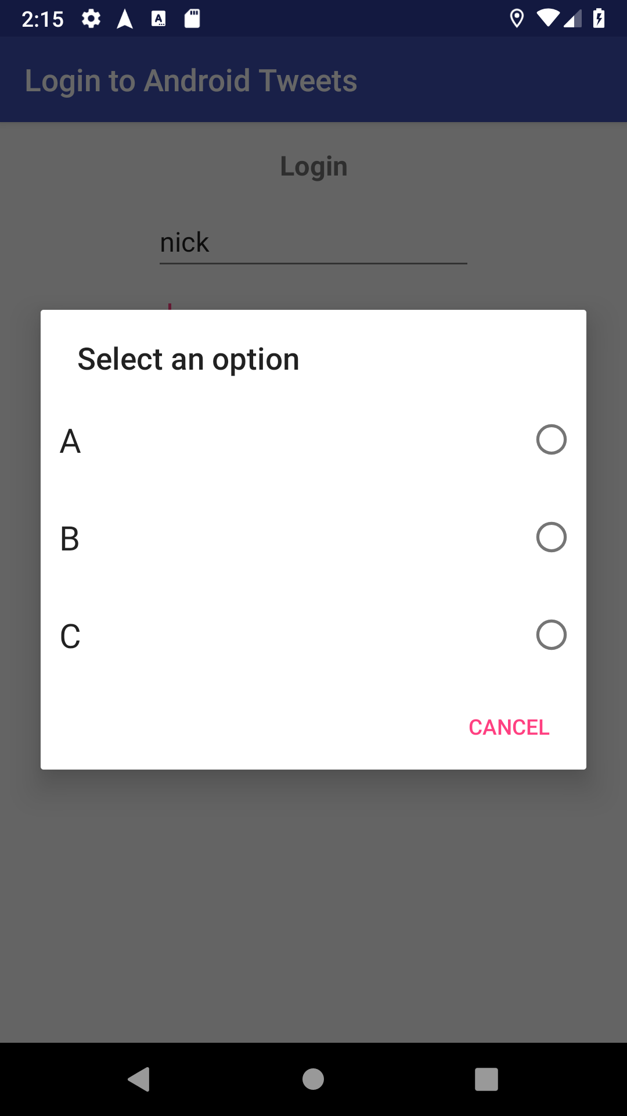
RadioButton Dialog
val choices = listOf("A", "B", "C")
// select_dialog_singlechoice is a pre-defined XML layout for a RadioButton row val arrayAdapter = ArrayAdapter<String>(this, android.R.layout.select_dialog_singlechoice) arrayAdapter.addAll(choices) AlertDialog.Builder(this) .setTitle("Select an option") .setAdapter(arrayAdapter) { dialog, which -> Toast.makeText(this, "You picked: ${choices[which]}", Toast.LENGTH_SHORT).show() } .setNegativeButton("Cancel") { dialog, which -> dialog.dismiss() } .show()

Slide 12
Questions?

Slide 13
Helpful Links
Building an Alert Dialog

